Slide 1
Front End Engineering-I Project
Team Details:
ANMOL - 2310991609
ANSH GOEL - 2310991610
ANSH VOHRA - 2310991611
Faculty Coordinator:
Dr. Mohammad Shuaib Khan
:
Chitkara University Institute of Engineering and Technology,
Chitkara University, Punjab

Slide 2
Table of Contents
Introduction
Problem Statement
Technical Details
Key Features
Project Highlights
Conclusion
References/Links used

Slide 3
Introduction
Title : Blog Page
Team Details:
2310991609 – Anmol
2310991610 – Ansh Goel
2310991611 – Ansh Vohra
Overview:
Our aim is to create a blog website by using HTML, CSS and JavaScript. This project will serve as a hands-on learning experience to enhance our HTML, CSS and JavaScript skills and gain practical knowledge in building a website.

Slide 4
Problem Statement
This project aims to solve problem of lack of quality content, writing style and also help the user with the suggestions as per his/her content.

Slide 5
Technical Details
HTML(Hypertext Markup Language):-
HTML was used to create the Basic Layout of the
Project. In HTML tags are used to indicate the
purpose of different elements on a webpage.
2. CSS(Cascading Stylesheets):-
CSS was used to add Design elements like colors,
font styles, and spacing to the Project and make it
Responsive.
3. Java Script:-
It is a programming language that makes your
website more interactive. It is used for
implementing complex features on web pages.

Slide 6
Key Features
The Header consist of a logo, website heading, home, gallery and sign in button . Below it there is a create your blog button to create blog.
CSS sheets are used to add Design Elements like colors, font styles, and spacing to the Project and add responsiveness. It is used to increase page speed and make page more attractive.
JavaScript is a scripting language used to develop web pages and allows developers to create a dynamic and interactive web page to interact with visitors.

Slide 7
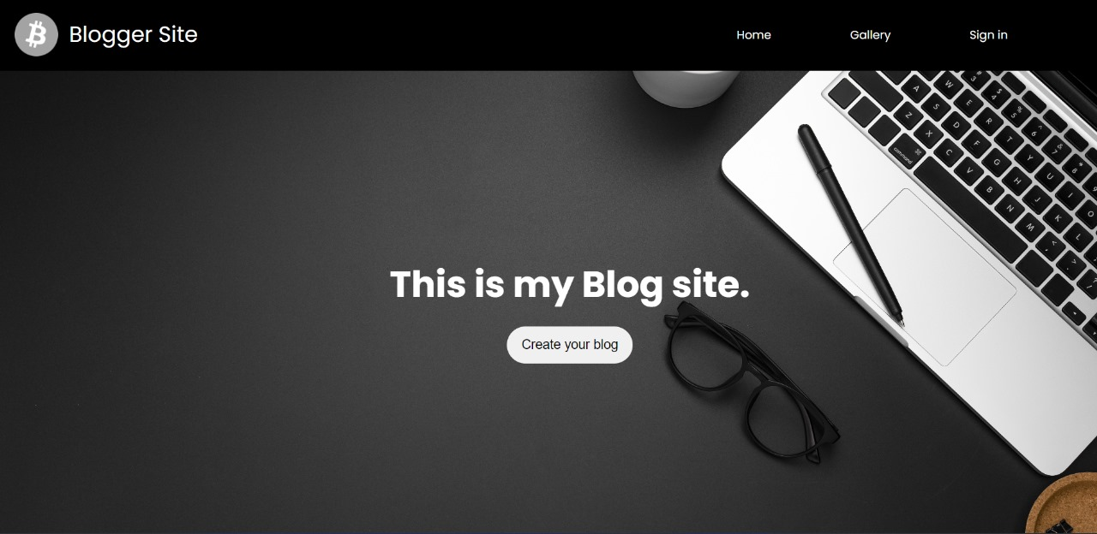
Project Highlights
Header Section

Slide 8
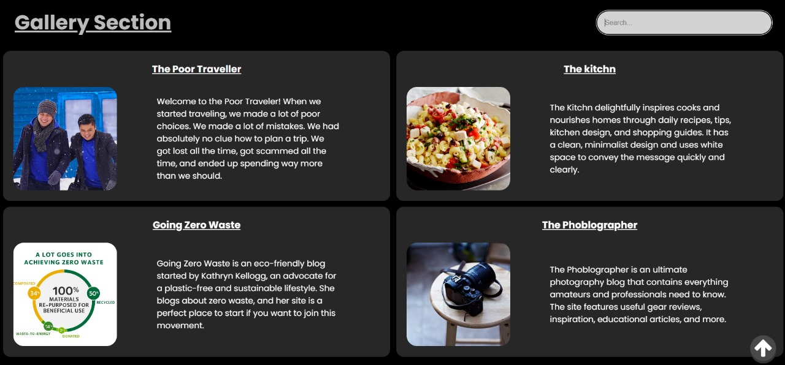
Gallery section

Slide 9
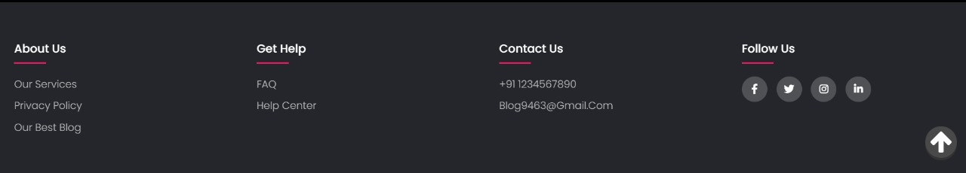
Footer Section

Slide 10
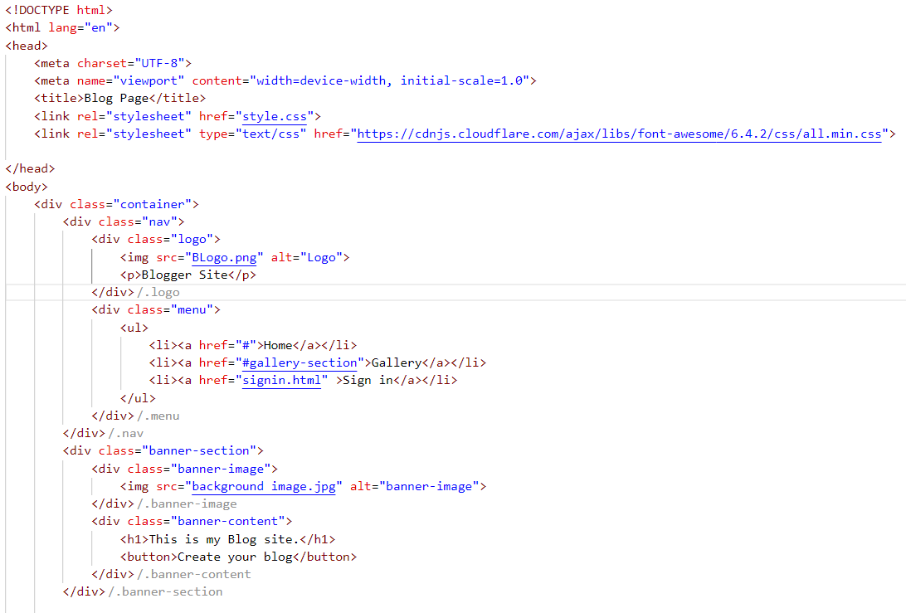
HTML LAYOUT 1

Slide 11
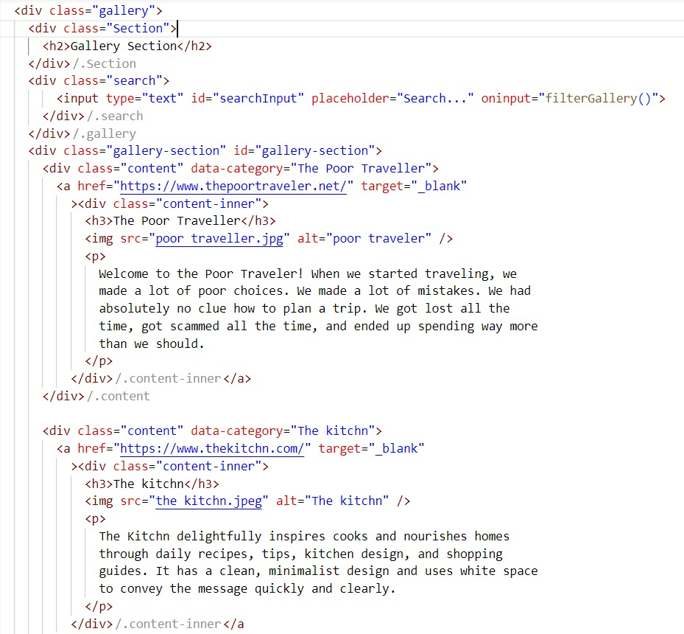
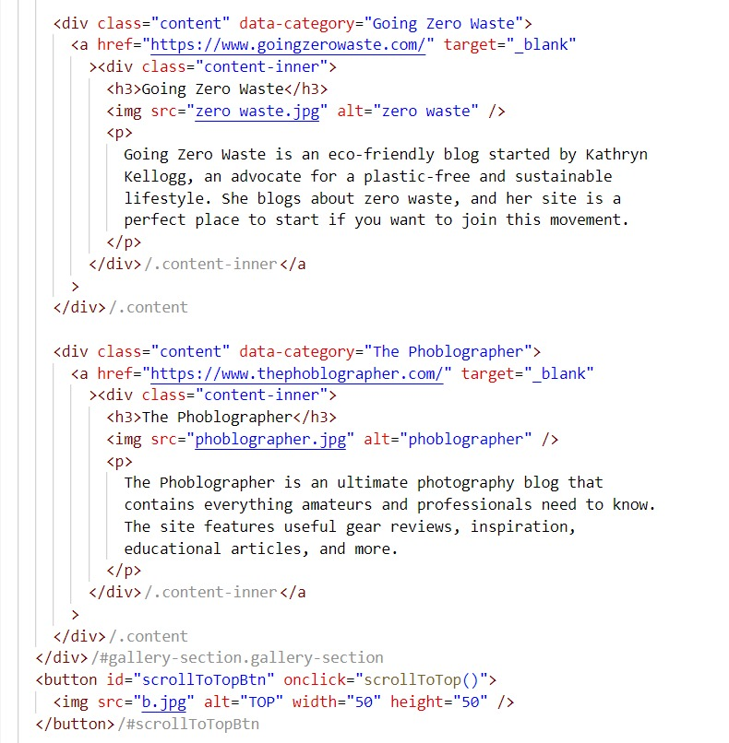
HTML LAYOUT 2

Slide 12
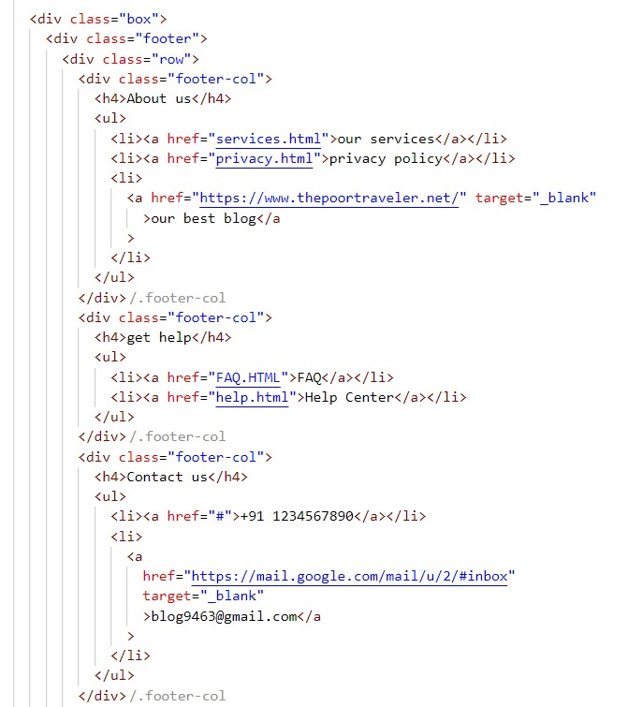
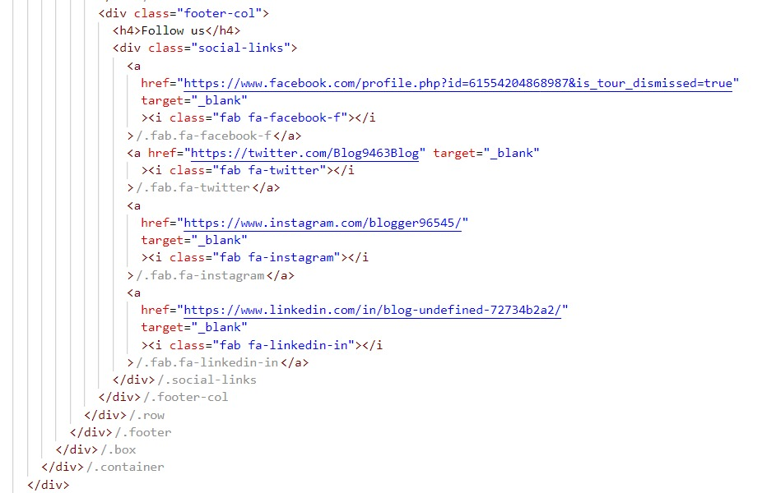
HTML LAYOUT 3

Slide 13
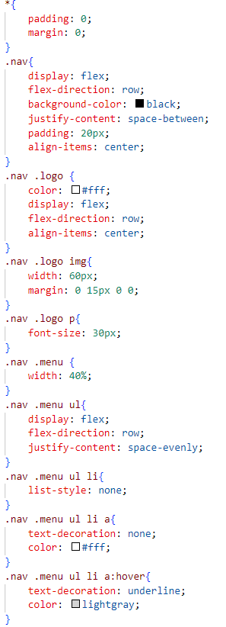
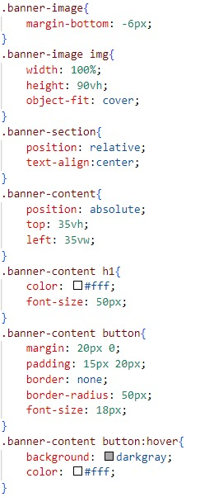
CSS STYLESHEET
Banner Section

Slide 14
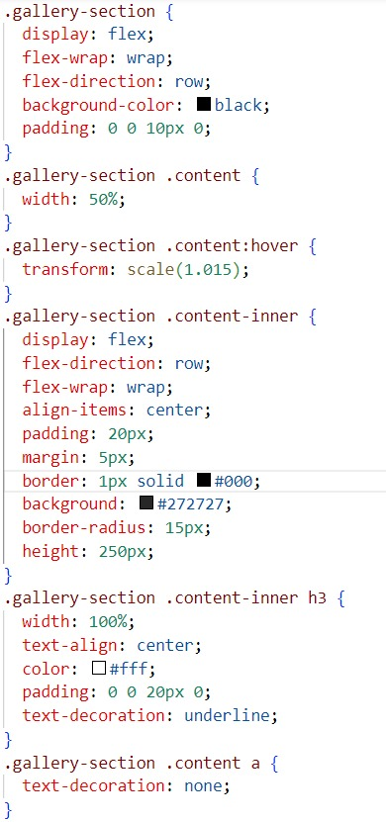
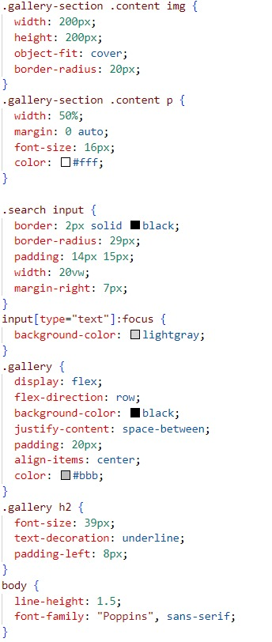
CSS STYLESHEET
Gallery Section

Slide 15
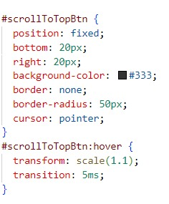
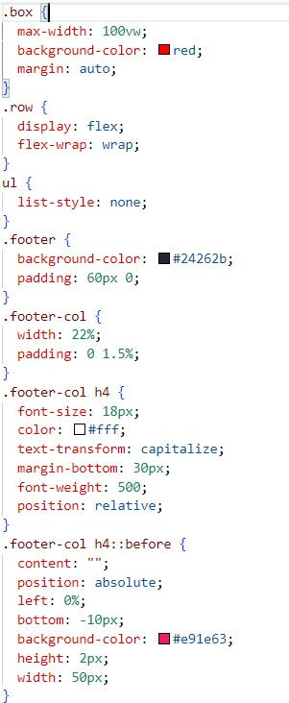
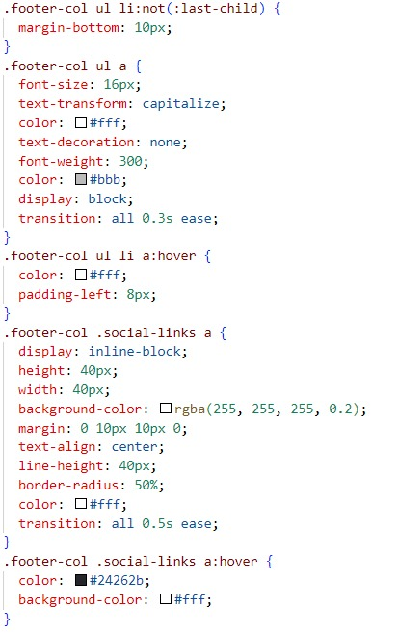
CSS STYLESHEET
Footer Section

Slide 16
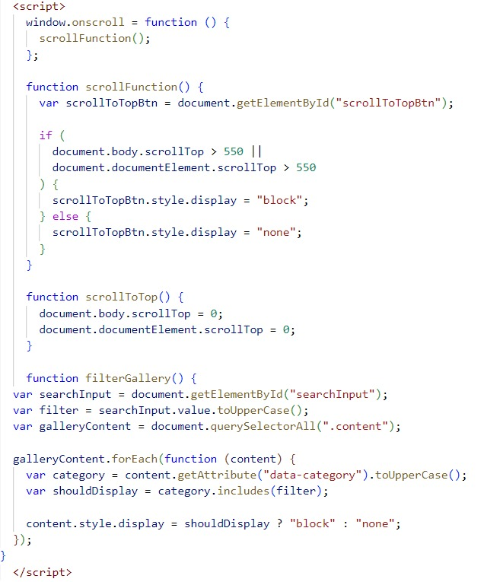
JavaScript

Slide 17
Conclusion
In conclusion, a well-designed blog post layout using HTML ,CSS and JavaScript can significantly enhance the visual appeal, readability, and user experience of your blog. By implementing the technique and strategies, you have the tools to create stunning, responsive blog post layouts that captivate your readers and keep them engaged with your content.

Slide 18
References/Links used
https://fonts.googleapis.com/css2?family=Poppins:wght@300;400;500;600;700&display=swap
https://developer.mozilla.org/en-US/docs/Web/HTML
https://www.freepik.com

Slide 19


